Slide 1
Argument Arrays
A command line consists of tokens (the arguments) that are separated by white space: blanks, tabs or a backslash (\) at the end of a line.
Command line corresponding to a C executable program
The shell parses the command line into tokens and passes the result to the program in the form of an argument array
An argument array is an array of pointers to strings. The end of the array is marked by an entry containing a NULL pointer
Notes:
1

Slide 2
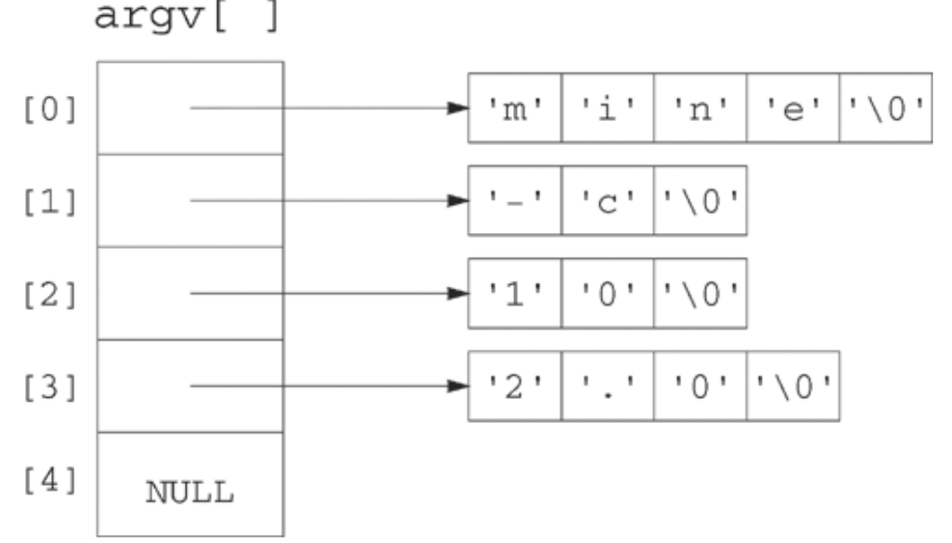
mine.c
int main(int argc, char *argv[])
{}
Compile $gcc –o mine mine.c
Run giving at the command prompt
mine -c 10 2.0

Slide 3
Creating an argument array with makeargv()
prototype for a makeargv function creates an argument array from a string of tokens.
1. char **makeargv(char *s);
string input parameter and
returns pointer to an argv array.
NULL pointer if fails.
2. int makeargv(char *s, char ***argvp);
argument array as a parameter
returns an integer i.e number of arguments.
makeargv returns –1 to indicate an error.
3. int makeargv(const char *s, const char *delimiters, char ***argvp);
const qualifier means that the function does not modify the memory pointed to by the first two parameters.

Slide 4
Invoke makeargv()
prototype 1 : char **makeargv(char *s);
main(){
int i;
char **myargv;
char mytest[] = "This is a test";
if ((myargv = makeargv(mytest)) == NULL)
fprintf(stderr, "Failed to construct an argument array\n");
else
for (i = 0; myargv[i] != NULL; i++)
printf("%d:%s\n", i, myargv[i]);
}
Write the function definition

Slide 5
Invoke makeargv()
Prototype 3 :
int makeargv(const char *s, const char *delimiters, char ***argvp);
#include <stdio.h>
#include <stdlib.h>
int makeargv(const char *s, const char *delimiters, char ***argvp);
int main(int argc, char *argv[]) {
char delim[] = " \t"; int I; char **myargv; int numtokens;
if (argc != 2) { fprintf(stderr, "Usage: %s string\n", argv[0]);
return 1; }
if ((numtokens = makeargv(argv[1], delim, &myargv)) == -1) {
fprintf(stderr, "Failed to construct an argument array for %s\n", argv[1]);
return 1;
}
printf("The argument array contains:\n");
for (i = 0; i < numtokens; i++)
printf("%d:%s\n", i, myargv[i]);
return 0;
}
}
Write the function definition

Slide 6
implementation strategy for definition
Use malloc to allocate a buffer t, large enough to contain s and its terminating `\0'.
Copy s into t
using strtok to count the tokens in t.
Use the count (numtokens) to allocate an argv array
Copy s into t again
Use strtok to obtain pointers to the individual tokens, modifying t and effectively parsing t in place

Slide 8
strtok() and strtok_r() functions in C
Splits a strings to individual tokens
#include <string.h>
char *strtok(char *restrict s1, const char *restrict s2);
The first call to strtok is different from subsequent calls.
On the first call, it parse the first argument, s1.
On subsequent calls for parsing the same string, pass a NULL for s1.
The second argument s2, is a string of allowed token delimiters.
The strtok function returns NULL when it reaches the end of s1.
restrict qualifier is requires that any object referenced by s1 cannot be accessed by s2.

Slide 9
Ex:
#include<string.h>
int main()
{
char str[] = "SOA-Deemed-University";
// Returns first token
char* token = strtok(str, "-");
while (token != NULL) {
printf("%s\n", token);
token = strtok(NULL, "-");
}
}
Notes:
Note: does not allocate new space for the tokens, but rather it tokenizes s1 in place.
9

Slide 10
strtok_r() is a reentrant version of strtok()
Syntax:
char *strtok_r(char *str, const char *delim, char **saveptr);
The third argument saveptr is a pointer to a char *
used internally by strtok_r() in order to maintain context between successive calls that parse the same string.

Slide 11
Ex: splitting string based on space character
int main()
{
char str[] = "Geeks for Geeks";
char* token;
char* rest = str;
while ((token = strtok_r(rest, " ", &rest)))
printf("%s\n", token);
return (0);
}
Notes:
11

Slide 12
Complete program
makeargv.c

